Slide 1

CNN Foundations
Convolution,
Spatial Arithmetic,
Receptive Field
Study Pack:
Notes
Quiz
A worked Example (Jupyter Notebook)
Simulator (Gradio platform)
Further reading / references
Michael Mizzi
May 2026
Repository Link: https://github.com/micmizzi/ARI5118-Deep-Learning-For-Computer-Vision_MMIZZI.git

Slide 2
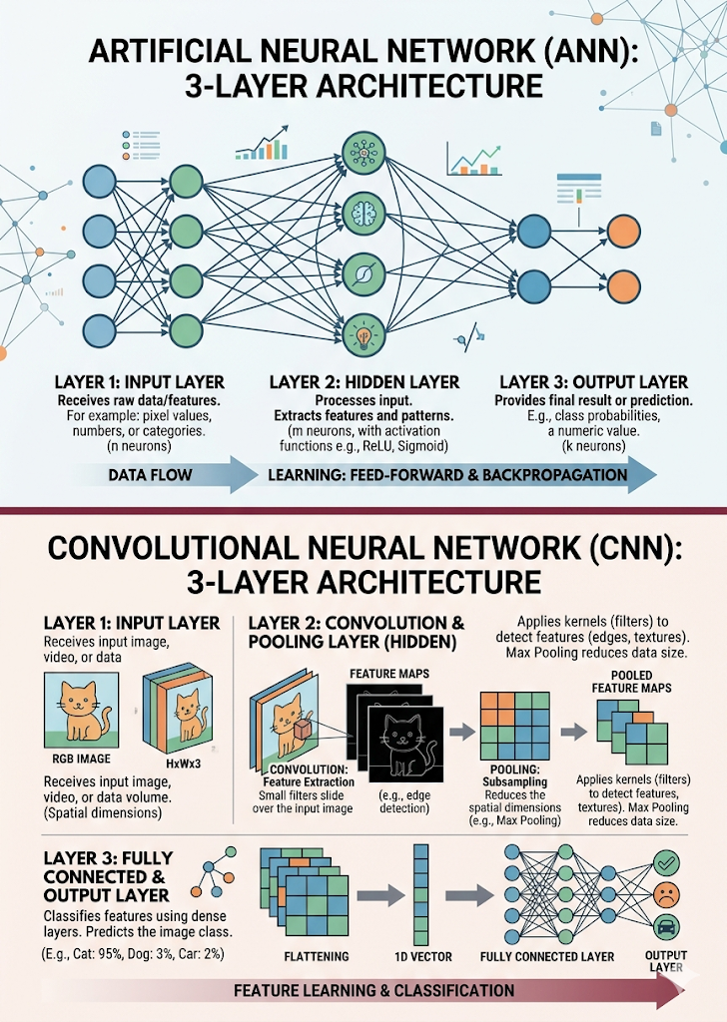
Why Traditional ANNs Fail
01
Standard Artificial Neural Networks struggle with visual data, suffering from excessive weight requirements, spatial data ignorance, and poor translation invariance.
Parameter Explosion
Small images need millions of weights, creating massive memory usage and overfitting risk.
02
Spatial Topology
Networks treat images as flat vectors, ignoring that nearby pixels are highly correlated.
03
Lack of Invariance
Networks lack translation invariance, failing to recognise objects shifted by a few pixels.

Slide 3
CNNs Mirror Biological Vision Through Local Connectivity
Local Vision
Efficiency
CNNs improve upon standard ANNs by focusing on small, local regions of input, effectively mimicking the human eye's ability to scan a scene for specific, immediate visual features.
By ensuring each neuron connects only to a small local input group rather than the whole image, CNNs achieve sparse connectivity, which drastically reduces total parameters.
Consistency
Hierarchy
The same kernel weight is reused across the entire image, allowing the network to detect a specific feature consistently, regardless of its exact location in the input data.
This structural design enables a sophisticated, efficient extraction pipeline, which progressively transforms raw pixel data into complex, high-level visual intelligence.

Slide 4
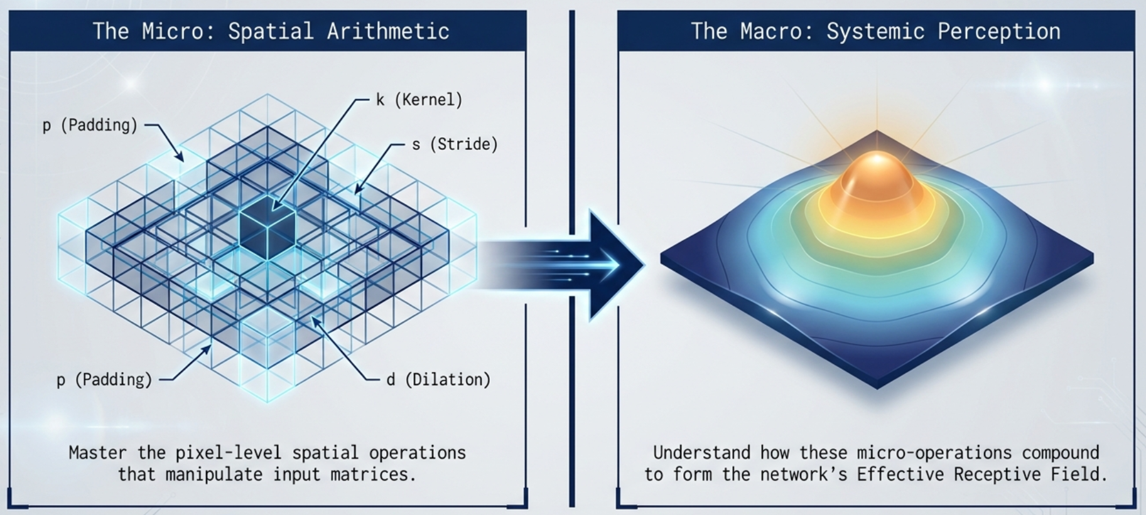

Slide 5
Deep Learning Fundamentals
Convolution Operation Mechanics
Sliding Window
1
A small array of weights, known as a kernel, moves across the input feature map at a set pace to scan the relevant regions systematically.
Multiplication
2
At each designated position, the kernel's individual weights are multiplied by the specific input units that they currently overlap directly.
Summation
3
These individual product results are summed together to produce a single definitive numerical value for that coordinate in the output map.
Integration
4
A linear transformation process designed to preserve spatial structure while effectively extracting core features from complex input data maps.
Distinct kernels are applied to each colour channel, and the resulting values are summed to create the final unified feature output map.

Slide 6
Kernel Architecture
Kernel Types in AI Vision
Standard Kernels
Dilated Kernels
These act as feature extraction workhorses, identifying oriented edges and simple corners.
Also known as Atrous, these inflate by spacing weights to expand the receptive field.
Transposed Kernels
Separable Kernels
Kernels, or filters, serve as the trainable eyes of a neural network. These architectural components are essential for processing visual data through distinct mathematical operations that extract, expand, upscale, or compress features depending on the model's specific requirements.
Used for upsampling in generation tasks, mapping small inputs into larger dimensions.
Decouple spatial and depth-wise operations, reducing footprint for compact applications.

Slide 7
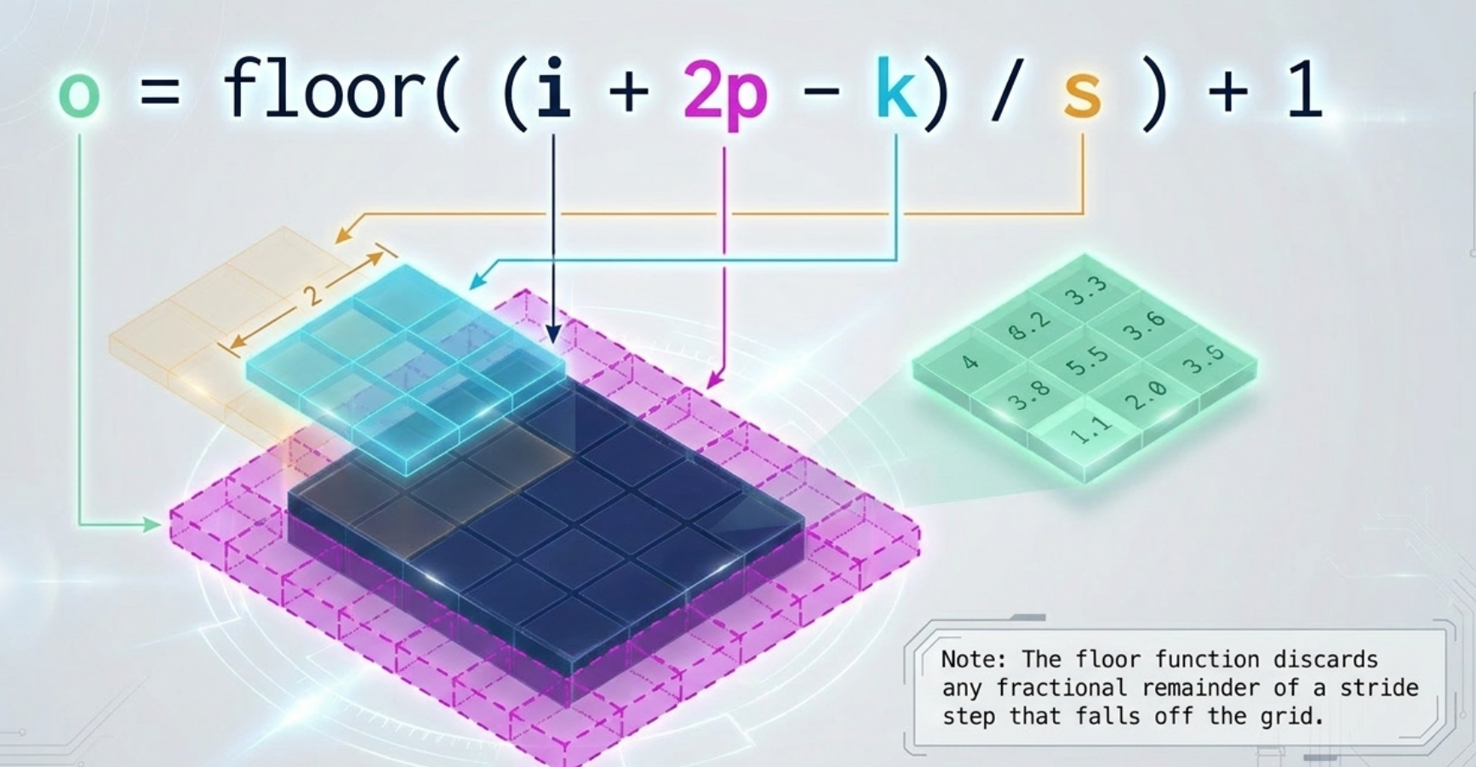

Slide 8
How Pooling and Stride Change Spatial Size
Stride controls sampling: stride s reduces each spatial dimension by about 1/s (floor behavior with borders)
Pooling (max/average) with size p and stride p typically reduces width and height by factor p and adds translation invariance
Effective output size: floor((input - kernel + 2*padding)/stride) + 1 for convolution and pooling
Clear rules for how pooling and stride reduce feature map dimensions and affect receptive field and computation
Larger stride or pooling reduces computation and memory but can lose fine spatial detail
Smaller stride or no pooling preserves resolution and spatial detail at higher compute cost
Using stride in convolution increases the receptive field like pooling while keeping learned filters
Common pattern: early pooling/stride for efficiency, later upsampling or dilated conv to recover spatial info
Summary: stride controls sampling; pooling reduces size and adds invariance — tradeoff between resolution and efficiency

Slide 9
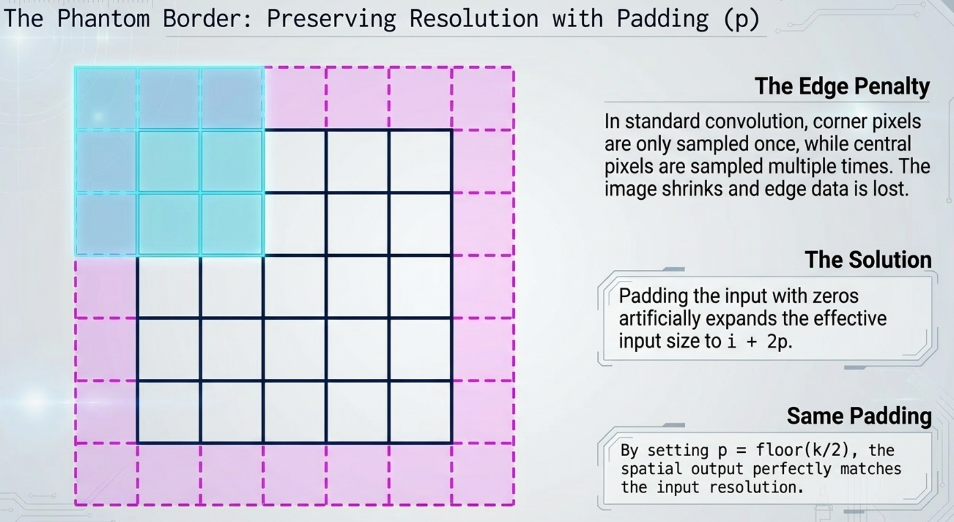

Slide 10
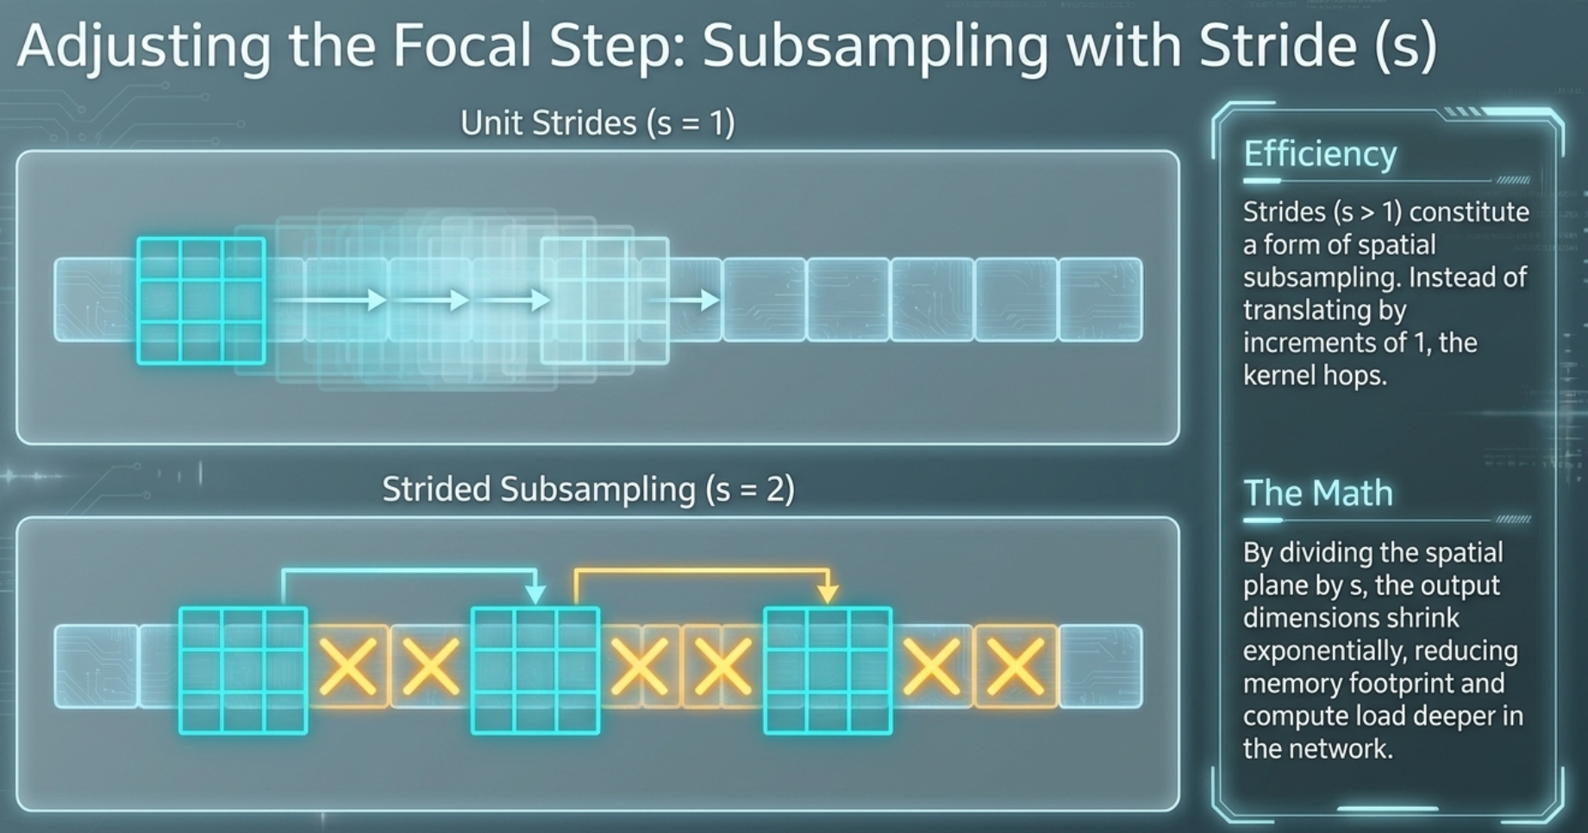

Slide 11
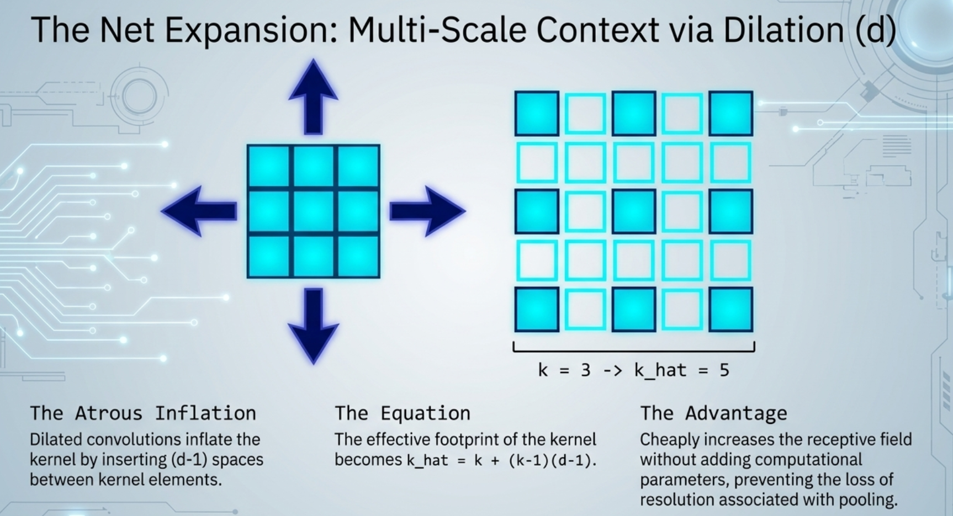

Slide 12
Mastering Spatial Dimension Arithmetic
1
3
Input Size (i)
Kernel Size (k)
1
2
CNN output dimensions rely on exact mathematical relationships between input size, kernel, padding, and stride. These variables govern information flow and computational efficiency within the network architecture.
Padding (p)
Stride (s)

Slide 13
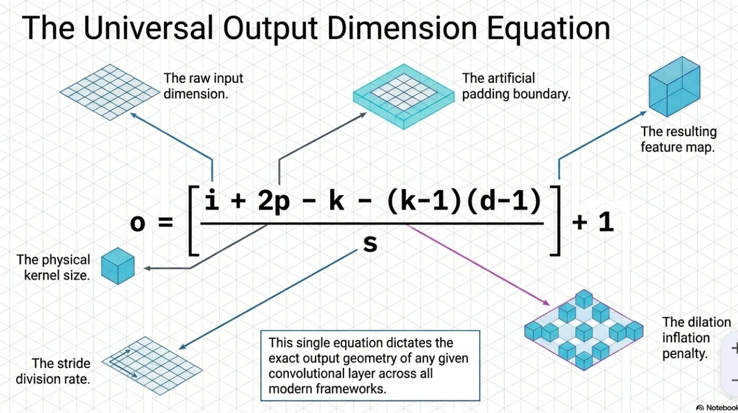
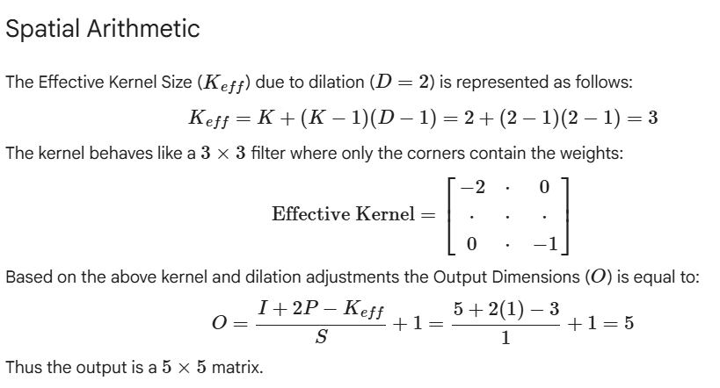
Compute Output Dimensions for Layers
Convolution output: (W - K + 2P) / S + 1 per dimension; round down for noninteger
Same padding: set P so output width equals input width when S is 1
Valid padding: P = 0, output shrinks by kernel size minus 1
Pooling output: use same formula as convolution with kernel K and stride S
Stride > 1 reduces spatial size: larger S means fewer outputs
Step-by-step guide to calculate output size for common layer combinations with clear rules and quick examples
Transpose convolution: inverse of conv—use output formula solving for output size
Fully connected: output units equal specified neuron count, flatten spatial dims first
Example check: Input 32x32 conv K=5 S=1 P=0 → 28x28 output
Validation tip: always compute per-dimension and confirm channel counts after layers

Slide 14

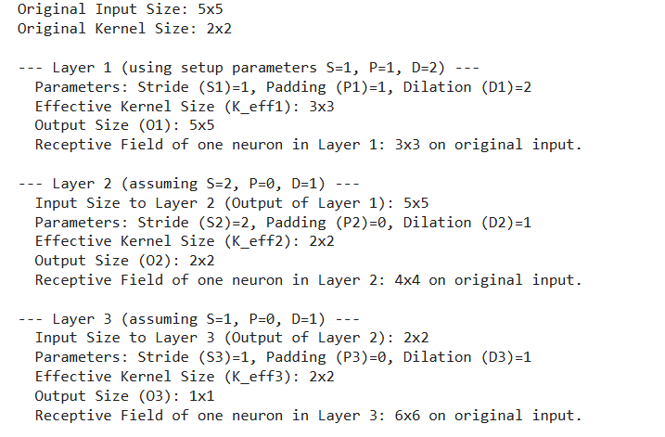
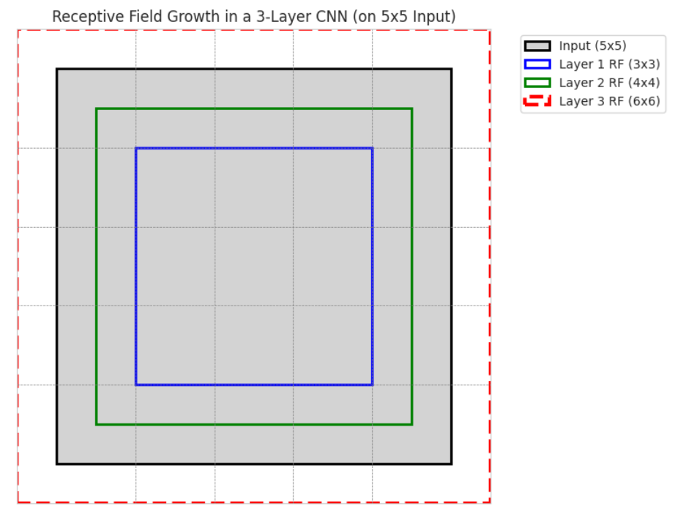
Expand the Receptive Field with Dilation
Increase spatial reach while keeping kernel parameters stable

Slide 15
RF vs. ERF
Distinguishing between the theoretical reach of a neural connection and its true effective impact on the final output.
Gaussian Influence
O(sqrt(n)) Scaling
Structural Effects
A concise subheading that supports the main message.
A concise subheading that supports the main message.
A concise subheading that supports the main message.
The Effective Receptive Field follows a Gaussian distribution, ensuring that central input pixels exert significantly greater influence than those at the outer periphery.
While theoretical receptive fields expand linearly at O(n) with deeper layers, the effective field scales more conservatively at a rate of O(sqrt(n)) as network depth increases.
Dilated convolutions and subsampling actively expand the effective field, whereas skip-connections, as seen in ResNets, can shrink it by narrowing the neuron's focus.

Slide 16
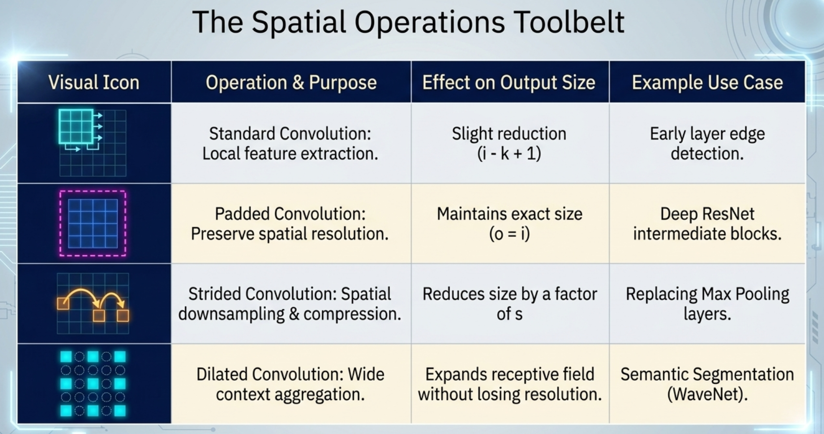

Slide 17
Milestones in Deep Learning Evolution
The trajectory of modern computer vision, from the commercial application of LeNet-5 to the breakthrough of AlexNet and the precision of Dilated Convolutions, demonstrates a shift toward automated gradient-based learning.
LeNet-5
AlexNet
Dilated Convolutions
Achieved the first major commercial success by utilising backpropagation to automate digit recognition for bank cheques.
Triggered a deep learning 'Big Bang' by using 60 million parameters and two GPUs to dominate the ImageNet competition.
Revolutionised semantic segmentation by aggregating multi-scale context without sacrificing critical spatial resolution.

Slide 18

Next Steps……
…….study notes
…….follow the Walkthrough notebook
…….visualize the impact of kernel size/type, padding, stride and dilation using the simulator
…….take the quiz (cross check answer and refer to feedback)
…….further reading available as required (refer to study notes / folder in repository
CNN Foundations ……on to the next topic …… Pooling

